Slide 1
How To Build
Basic Desktop Applications
in Ruby
RubyConf 2024 Workshop (2h) • Thursday, November 14, 2023 11:15a-1:15p
Andy Maleh • Senior Software Engineer • Lexop
Fukuoka Ruby 2022 Special Award Winner • RailsConf/RubyConf Speaker
Notes:
Ask audience:
Who here knows what a Native GUI App is?
Why would you build a Native GUI App?
How many people have experience with Native GUI App development or desktop development in general?

Slide 2
Outline
GUI Basics
MVC Software Architecture
MVP & Data-Binding
Advanced Data-Binding
Custom Components (Bonus)

Slide 3
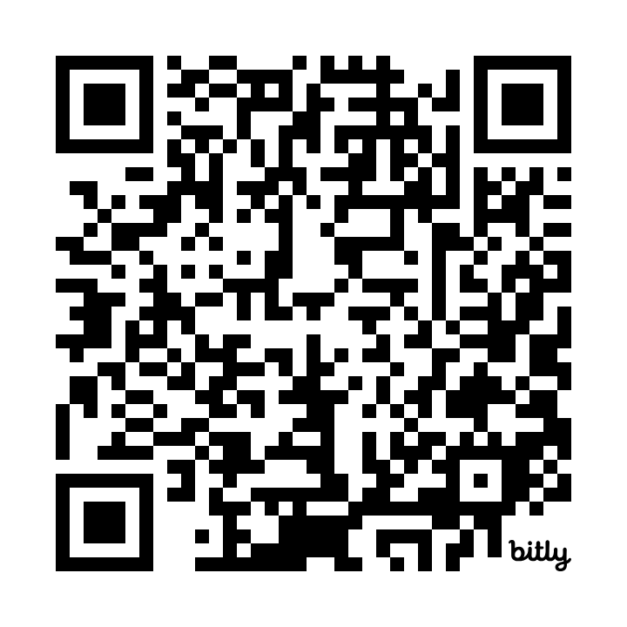
bit.ly/rubyconf2024desktop
Presentation Slides for How To Build Basic Desktop Applications in Ruby

Slide 4
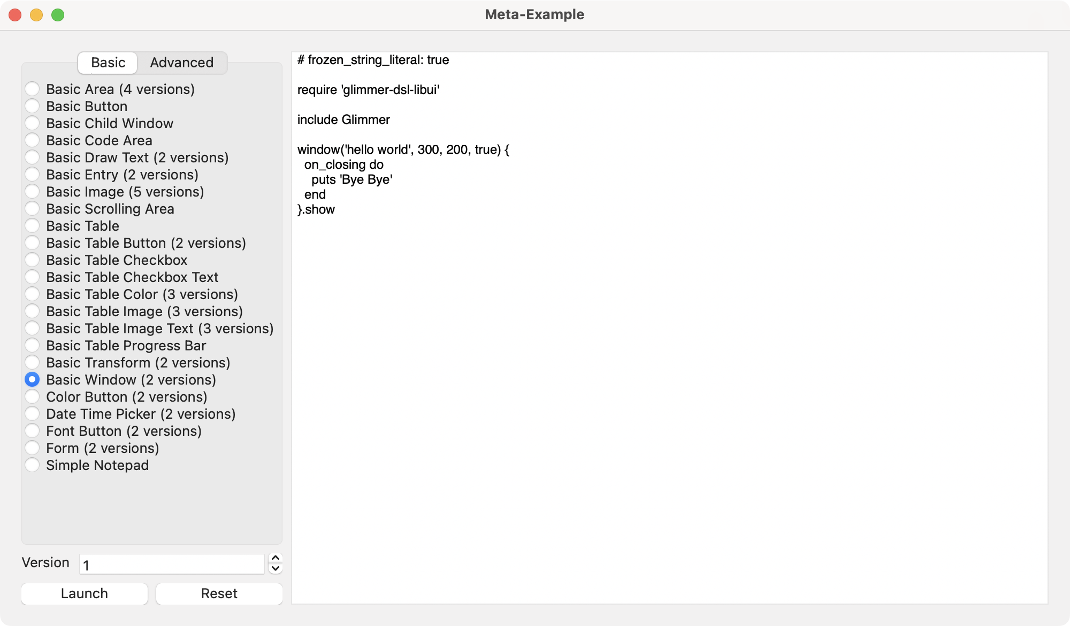
Setup Glimmer DSL for LibUI
Follow presentation slides at: bit.ly/rubyconf2024desktop
Open Terminal/Command-Prompt/Git-Bash
Install this gem:
gem install glimmer-dsl-libui
Run this command to launch Glimmer Meta-Example:
glimmer examples

Slide 5
Intro GUI Examples

Slide 6
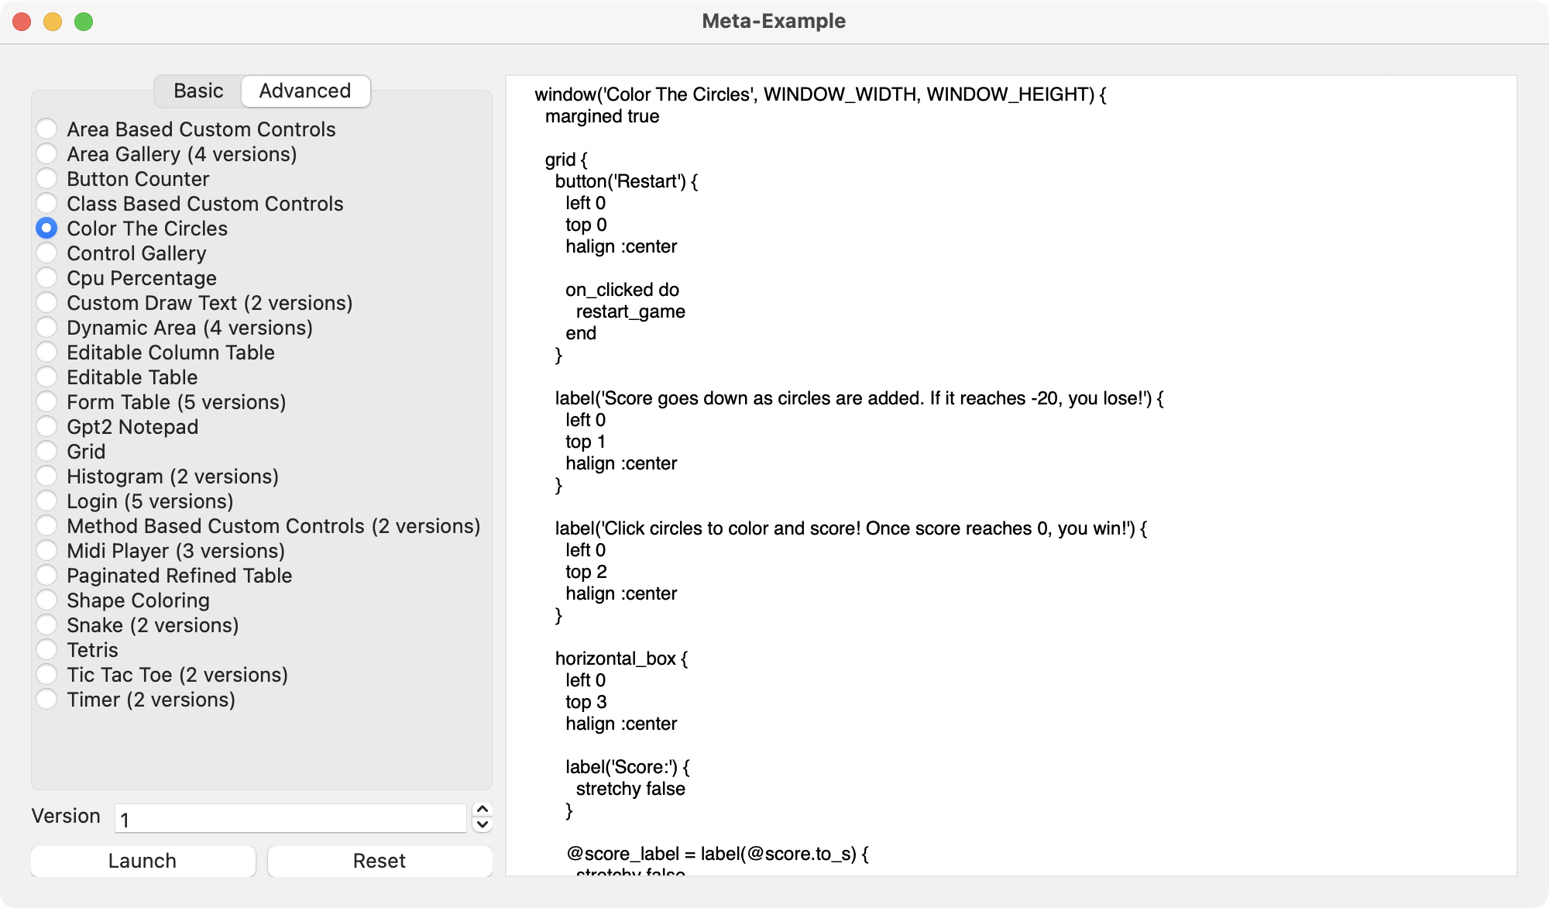
Intro GUI Examples

Slide 7
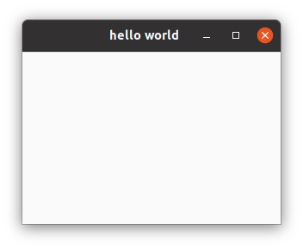
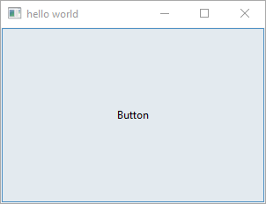
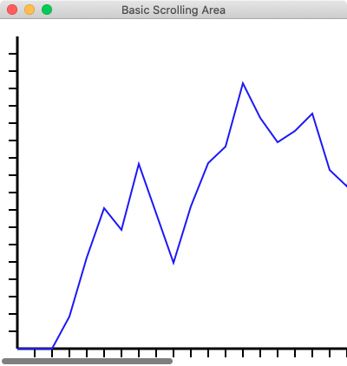
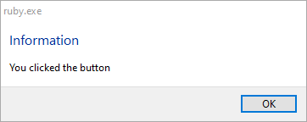
Basic Examples

Slide 8
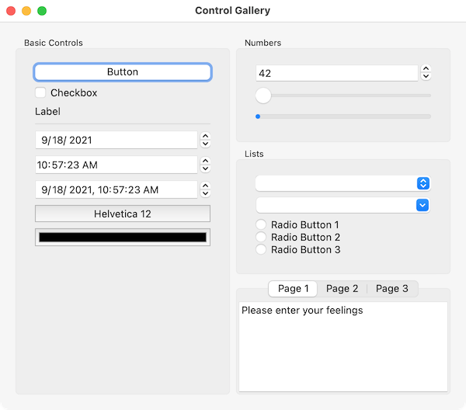
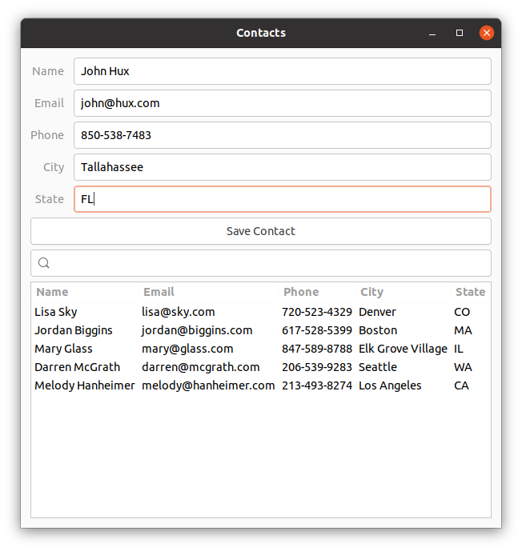
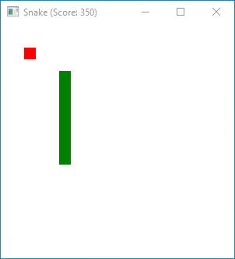
Advanced Examples

Slide 9
Section 1
GUI Basics

Slide 10
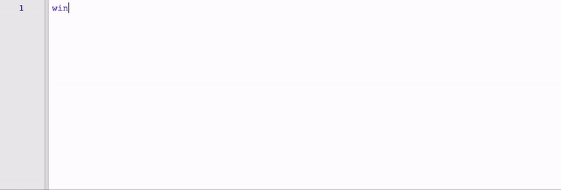
Introduction To Glimmer
Source: Glimmer DSL for SWT

Slide 11
Glimmer DSL for LibUI Design Principles
The Ruby Way (including TIMTOWTDI: There Is More Than One Way To Do It)
Requiring the least amount of syntax possible to build GUI (Graphical User Interface)
Declarative syntax that visually maps to the GUI control hierarchy
Ability to mix declarative and imperative code conveniently without needing awkward & verbose technologies (e.g. no XML, HTML, ERB scriptlets, JSX)
Computers serve Software Engineers (not Software Engineers serve Computers)
Think only about real world concepts directly relevant to the GUI and interacting with it (no weird non-real-world irrelevant concepts like hooks/effects/immutability)
The Rails Way Convention over Configuration via smart defaults and automation of low-level details
Modular Software Design (e.g. support for Components)
No premature optimization

Slide 12
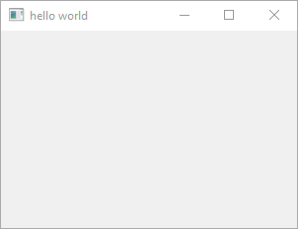

GUI DSL Basics
Glimmer GUI DSL enables building Graphical User Interfaces with a Ruby embedded (internal) Domain Specific Language
1) Control Keyword
Underscored case
Declarative control construction
Ruby method behind the scenes

Slide 13
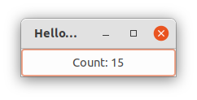

GUI DSL Basics
1) Control Keyword
Underscored case
Declarative control construction
Ruby method behind the scenes

Slide 14
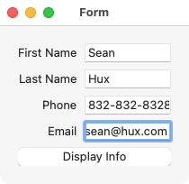

GUI DSL Basics
1) Control Keyword
Underscored case
Declarative control construction
Ruby method behind the scenes

Slide 15

GUI DSL Basics
1) Control Keyword
Underscored case
Declarative control construction
Ruby method behind the scenes

Slide 16
Controls
area
button
checkbox
code_area
combobox
color_button
date_time_picker
editable_combobox
entry
font_button
form
grid
group
horizontal_box
horizontal_separator
image
label
Full list at: Glimmer DSL for LibUI Supported Keywords

Slide 17
More Controls
menu
menu_item
message_box
multiline_entry
password_entry
progress_bar
radio_buttons
scrolling_area
slider
spinbox
tab
tab_item
table
time_picker
vertical_box
vertical_separator
window
Full list at: Glimmer DSL for LibUI Supported Keywords

Slide 18

GUI DSL Basics
2) Control Arguments
Optional
Match LibUI C API

Slide 19
GUI DSL Basics
2) Control Arguments
Optional
Match LibUI C API

Slide 20
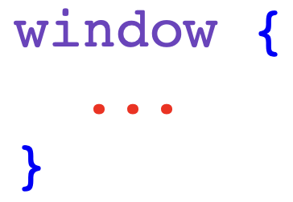
GUI DSL Basics
3) Control Content Block
Properties
Listeners
Nested Controls

Slide 21
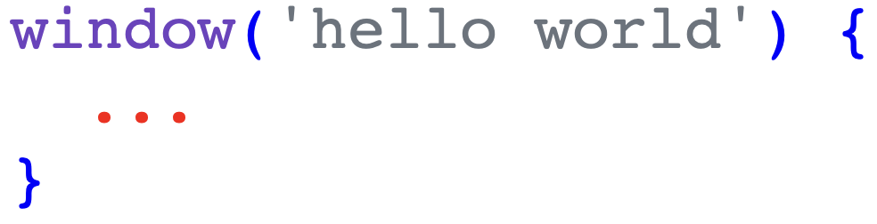
GUI DSL Basics
3) Control Content Block
Properties
Listeners
Nested Controls

Slide 22
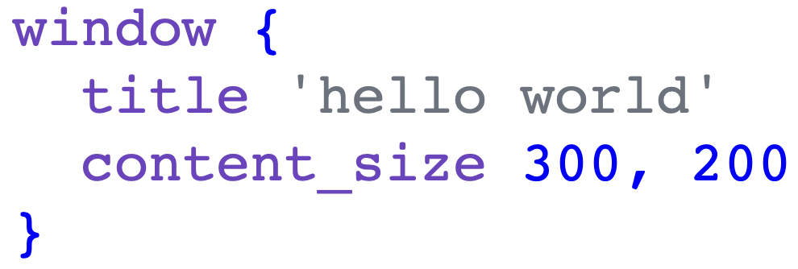
GUI DSL Basics
3a) Control Content Block - Properties

Slide 23
Control Properties
text
checked
editable
selected
color
time
margined
padded
value
items
read_only
title
width
height
Full list at: Glimmer DSL for LibUI Supported Keywords

Slide 24
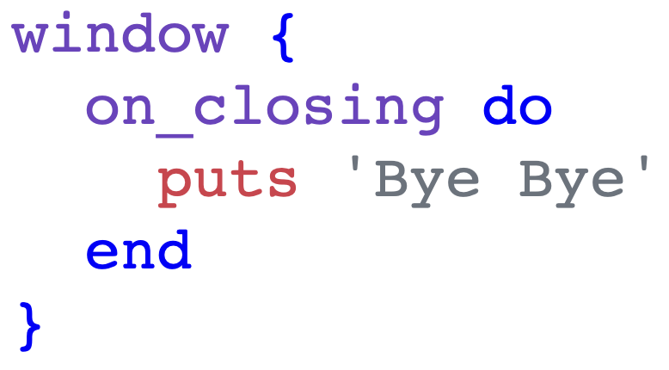
GUI DSL Basics
3b) Control Content Block - Listeners
Have `on_` prefix
Observer Pattern
Imperative code block

Slide 25
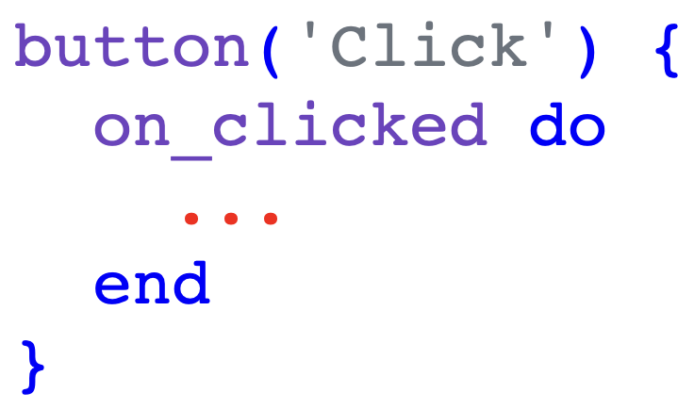
GUI DSL Basics
3b) Control Content Block - Listeners
Have `on_` prefix
Observer Pattern
Imperative code block

Slide 26
Control Listeners
on_clicked
on_changed
on_toggled
on_closing
on_content_size_changed
on_destroy
on_draw
on_selected
on_edited
on_mouse_down
on_mouse_up
on_mouse_drag_started
on_mouse_dragged
on_mouse_dropped
on_mouse_entered
on_mouse_exited
on_key_down
on_key_up
Full list at: Glimmer DSL for LibUI Supported Keywords

Slide 27
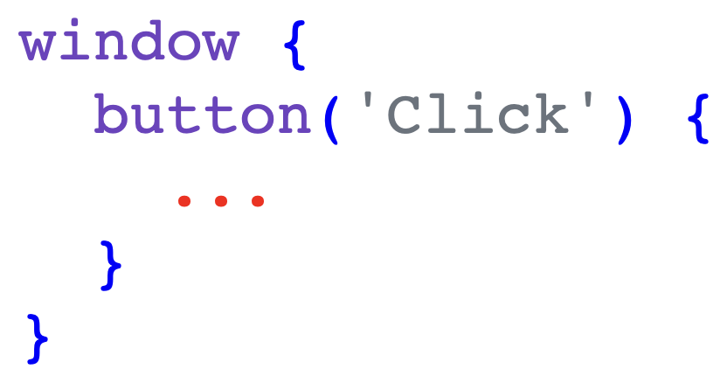
GUI DSL Basics
3c) Control Content Block - Nested Controls
Declarative Hierarchy
Composite Pattern

Slide 28
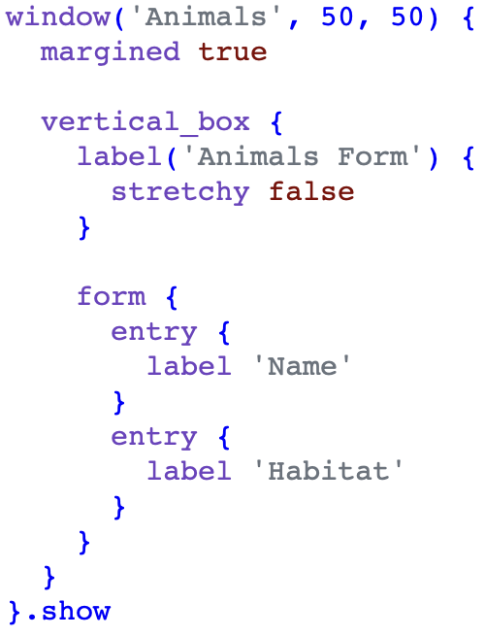
GUI DSL Basics
3d) Control Content Block - Layouts
Layout controls:
vertical_box
horizontal_box
form
grid (unstable)
Inside box layouts, stretchy prop decides taking all space or not
Inside form layout, label prop generates label for each control

Slide 29
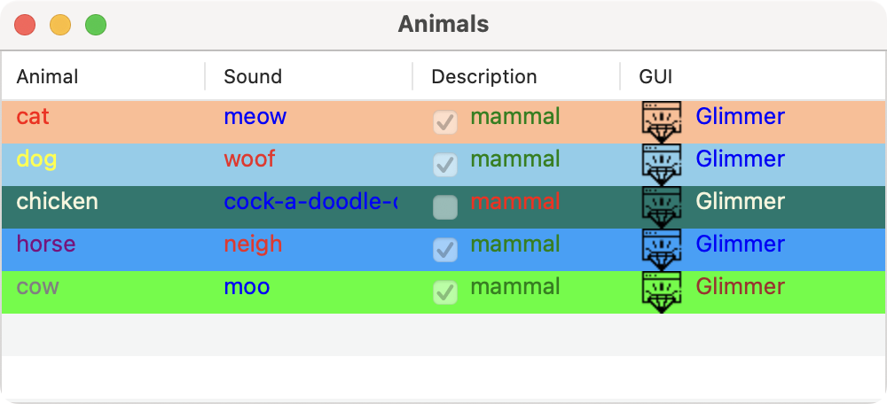
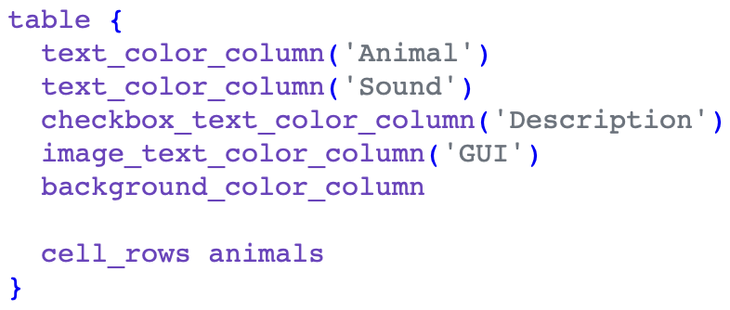
GUI DSL Basics
3e) Control Content Block - Table Columns
Columns can be nested under table:
background_color_column
checkbox_column
checkbox_text_column
checkbox_text_color_column
image_column
image_text_column
image_text_color_column
text_column
text_color_column
progress_bar_column

Slide 30
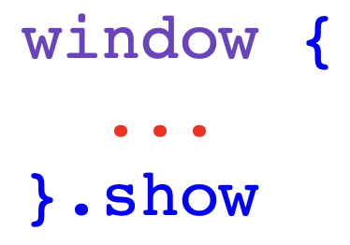
GUI DSL Basics
4) Control Operations
Invoked through Ruby Methods
Match LibUI C API
Proxy calls to wrapped LibUI objects
Include access to control properties after construction
Behavior is sometimes augmented with smart defaults
e.g. window.show starts GUI event loop

Slide 31
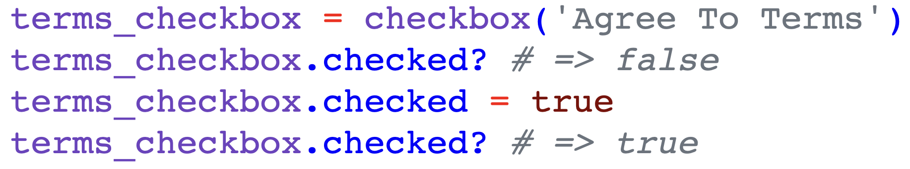
GUI DSL Basics
4) Control Operations (Ruby object methods)

Slide 32
Section 1
GUI Basics
Exercises

Slide 33
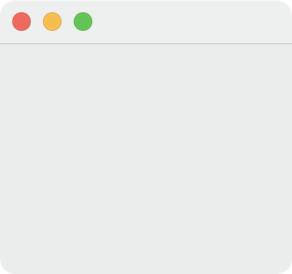

Exercise 1: Empty Window
Ensure Glimmer Meta-Example is open
Go to Basic Window example
Delete all code below include Glimmer
Add this code in place of old code and launch app:

Slide 34
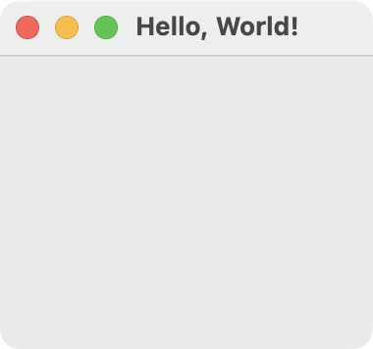
Exercise 2: Hello, World! Window w/ Args
Add this code in place of last code and launch app:

Slide 35
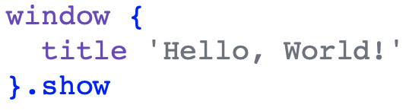
Exercise 3: Hello, World! Window w/ Props
Add this code in place of last code and launch app:

Slide 36
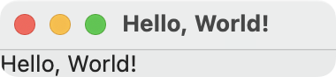
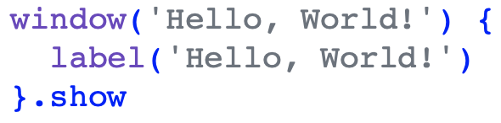
Exercise 4: Hello, World! Window + Label w/ Args
Add this code in place of last code and launch app:

Slide 37
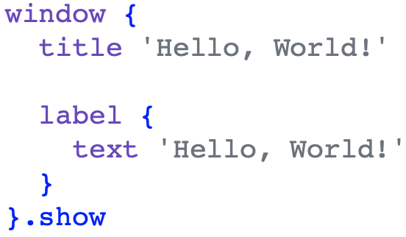
Exercise 5: Hello, World! Window + Label w/ Props
Add this code in place of last code and launch app:

Slide 38
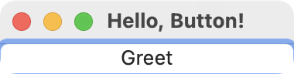
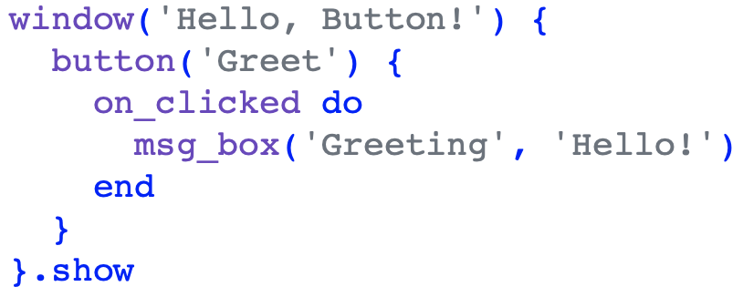
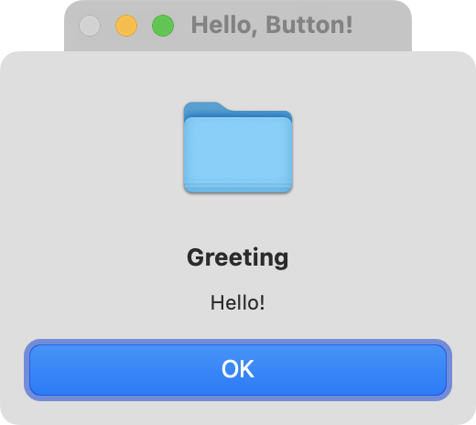
Exercise 6: Hello, Button!
Add this code in place of last code and launch app:

Slide 39
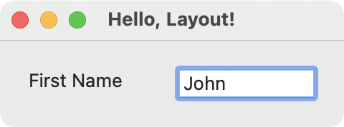
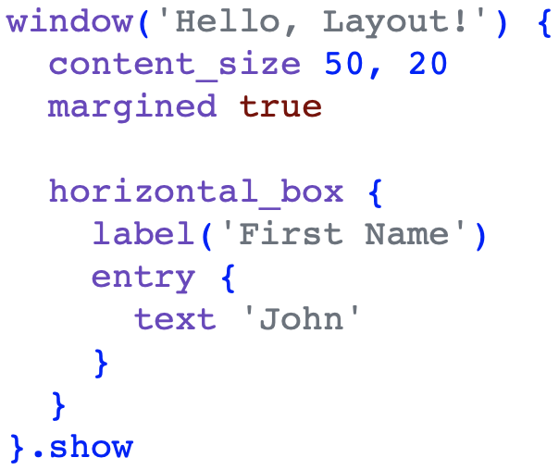
Exercise 7: Hello, Layout! w/ Horizontal Box
Add this code in place of last code and launch app:

Slide 40
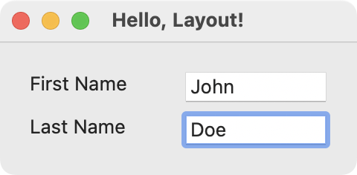
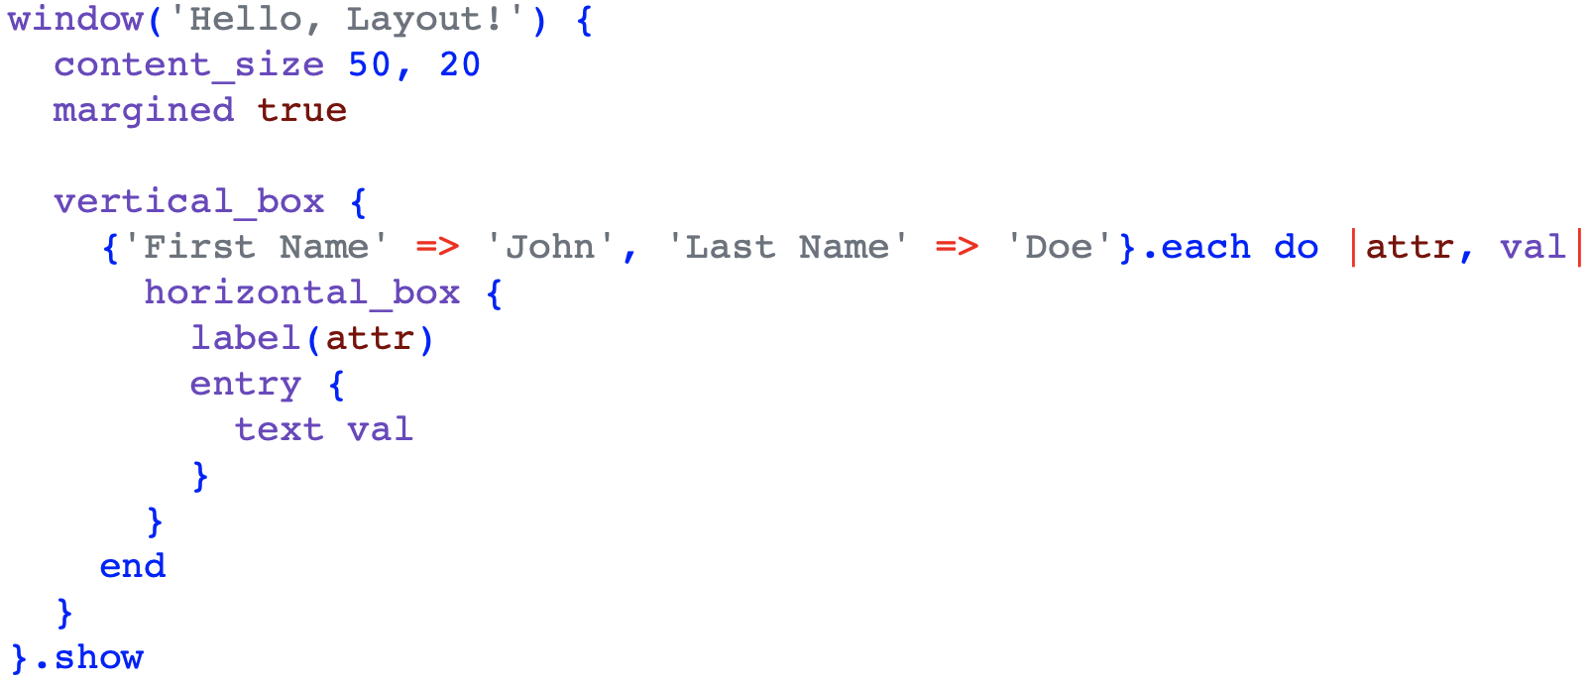
Exercise 8: Hello, Layout! w/ Horizontal & Vertical Boxes
Add this code in place of last code and launch app:

Slide 41
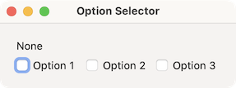
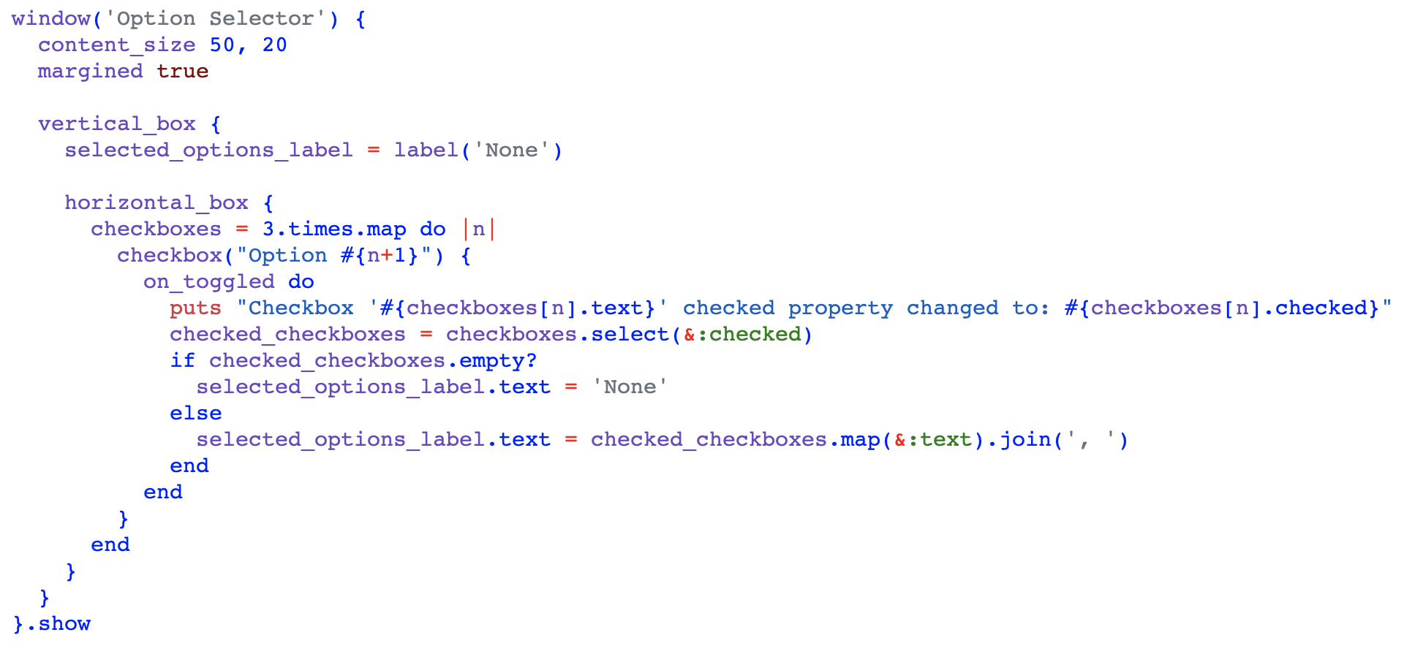
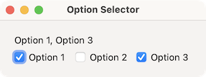
Exercise 9: Option Selector

Slide 42
Section 2
MVC Software Architecture

Slide 43
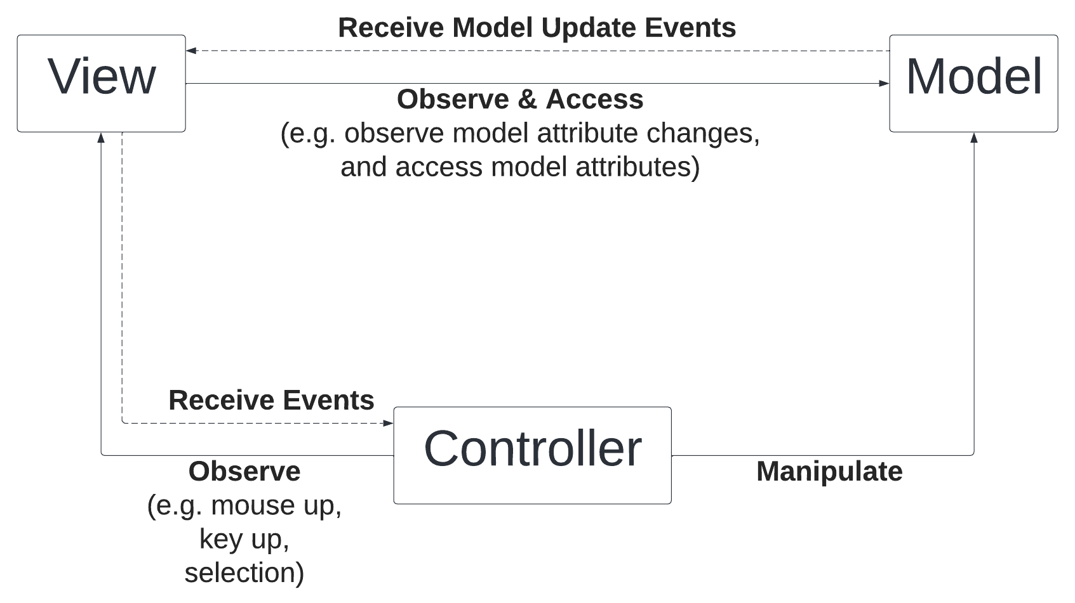
MVC Software Architecture

Slide 44
Observer Pattern
Observer Design Pattern is foundational in MVC Architectural Pattern
In MVC (Model-View-Controller):
Controller observes View for user actions (e.g. mouse/keyboard) and trigger changes in Model
View observes Model for domain data changes and updates itself
In Glimmer GUI DSL (Graphical User Interface Domain Specific Language):
Controller can rely on Listeners to observe View actions and trigger changes in Model
View can rely on observe(model, attribute) method to observe a Model attribute for changes and update its controls accordingly. It relies on Ruby Meta-Programming to auto-enhance a Model into an ObservableModel

Slide 45
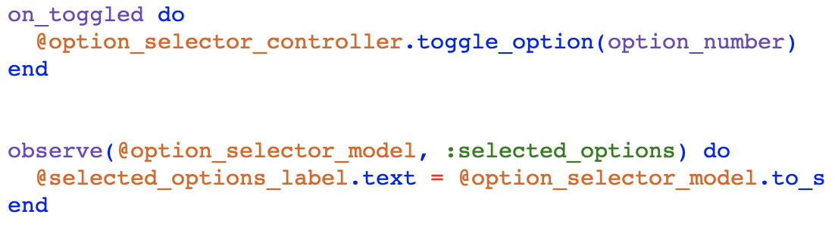
MVC Example - Explicit Controller
View observed by Explicit Controller to indirectly toggle option in Model
Model observed by View to indirectly update View label text when Model changes

Slide 46
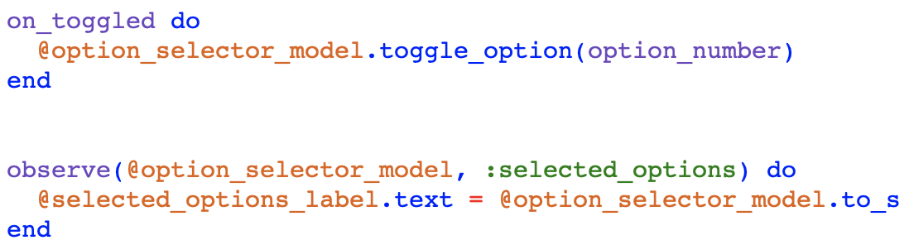
MVC Example - Implicit Controller
View observed by Implicit Controller (Listener) to directly toggle option in Model
Model observed by View to indirectly update View label text when Model changes

Slide 47

GitHub Repo for RubyConf 2024 Workshop: How To Build Desktop Applications in Ruby

Slide 48
Setup Workshop GitHub Repository
Before moving forward, please clone this GitHub repo (“⭐️” on GitHub):
git clone https://github.com/AndyObtiva/how-to-build-desktop-applications-in-ruby
Enter repo directory and run: bundle
This repo contains code for all the exercises of the workshop, organized by section and exercise number.
The Resources section includes links for helpful references
Further exercises are too large to type by hand from the slides, so it will be better to run them directly from the repo instead.

Slide 49
Section 2
MVC Software Architecture
Exercises

Slide 50
Section 3
MVP & Data-Binding

Slide 51
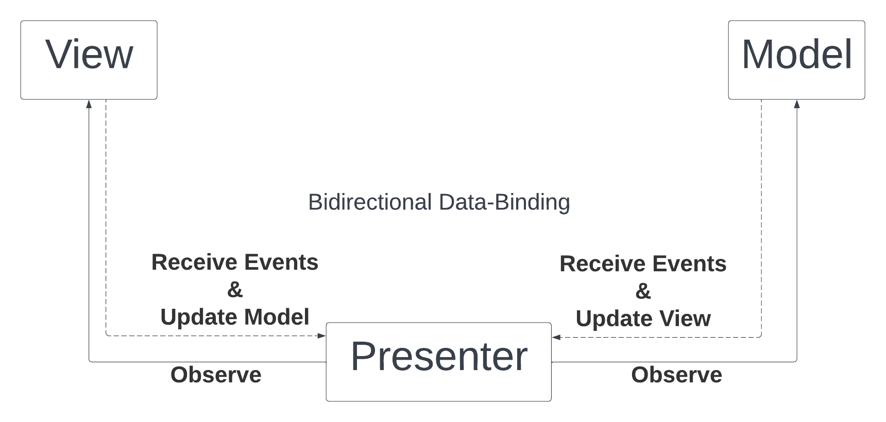
MVP & Data-Binding Software Architecture

Slide 52
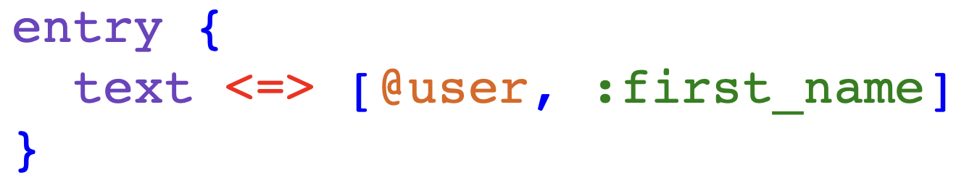
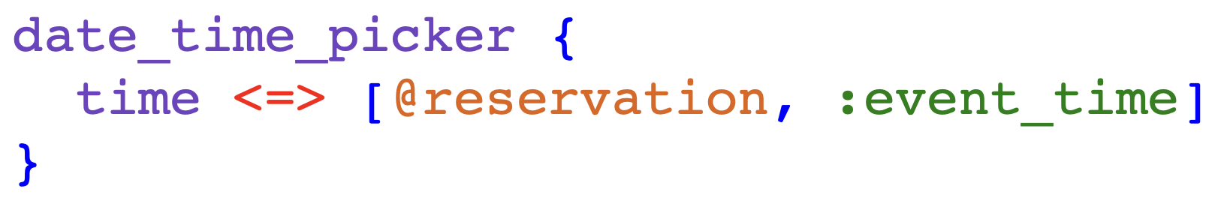
Property Data-Binding
Property Data-Binding declaratively & automatically synchronizes View properties w/ Model attributes bidirectionally or unidirectionally
Bidirectional (two-way) with <=> for View read/write properties

Slide 53
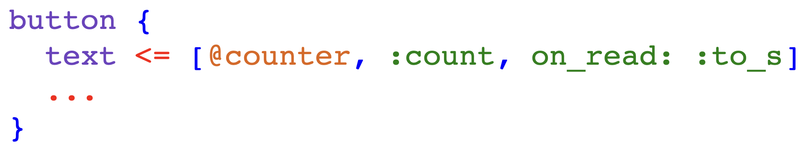
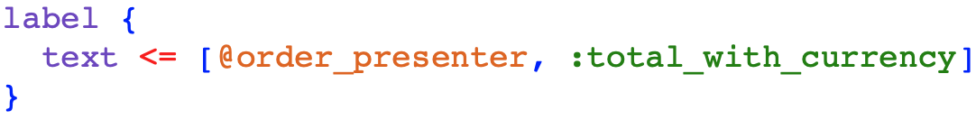
Property Data-Binding
Unidirectional (one-way) with <= for View read-only properties

Slide 54
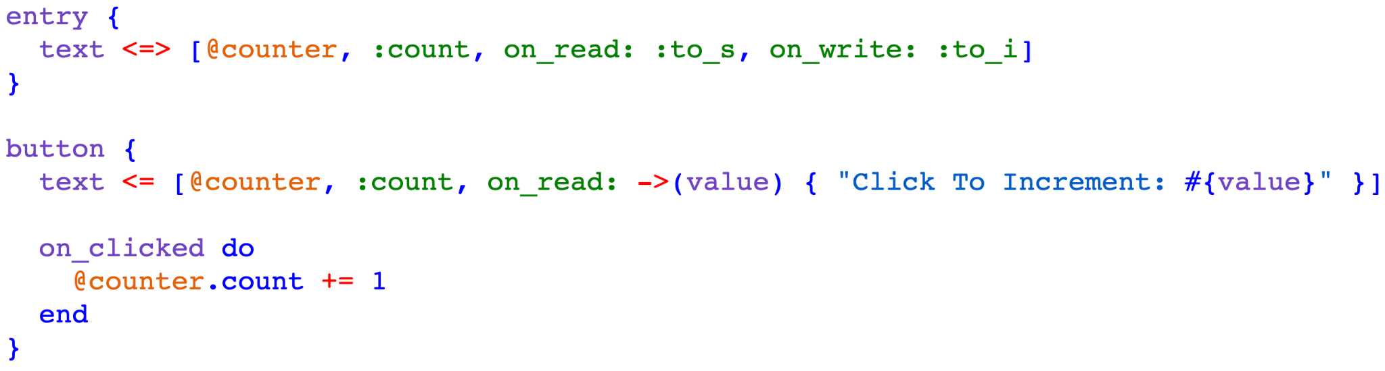

MVC+MVP Data-Binding Example

Slide 55

Table Data-Binding
table cell_rows can be data-bound to an array of models/hashes or Enumerator/Enumerator::Lazy for lazy-loading
Table data-binding automatically detects model attributes from column names by convention
Setting editable true enables editing table & bidirectional data-binding

Slide 56

Table Data-Binding
table cell_rows column mapping may still be customized manually if needed by passing in column_attributes option

Slide 57
Content Data-Binding
Content Data-Binding declaratively & automatically generates (re-renders) View content in response to Model attribute changes
Under a control, nest dynamically generated content inside an explicit content block that specifies the model and attribute to observe:
content(model, attribute) {
… # controls to generate dynamically
}

Slide 58



Content Data-Binding Example

Slide 59
Section 3
MVP & Data-Binding
Exercises
Notes:
Specify what to do in exercises 13, 14, and 16

Slide 60
Section 4
Advanced Data-Binding

Slide 61
Advanced Data-Binding
Data-Binding Converters
Data-Binding Hooks
Computed Data-Binding
Nested Data-Binding
Indexed Data-Binding
Keyed Data-Binding
Details at: Glimmer DSL for LibUI Data-Binding API

Slide 62

Data-Binding Converters
Data-Binding Converters enable:
Transforming Model attributes (on read) before displaying in View
Transforming View properties before storing in Model (on write)
on_read: -> (val) {...} : convert on read from Model to View
on_write: -> (val) {...} : convert on write to Model from View

Slide 63

Data-Binding Converter Example
Dynamic Form

Slide 64
Data-Binding Hooks
Data-Binding Hooks perform actions before and/or after copying data between View properties and Model attributes
before_read: -> (val) {...} : do work before reading data from Model to View and before on_read converter is called
after_read: -> (val) {...} : do work after reading data from Model to View and after on_read converter is called
before_write: -> (val) {...} : do work before writing data to Model from View and before on_write converter is called
after_write: -> (val) {...} : do work after writing data to Model from View and after on_write converter is called

Slide 65


Data-Binding Hook Examples

Slide 66

Computed Data-Binding
Computed Data-Binding enables observing extra Model attributes that are dependencies of a computed Model attribute so that when any of the extra attributes change, the View is updated from the computed attribute accordingly.
Examples:

Slide 67
Nested/Indexed/Keyed Data-Binding
Nested data-binding enables data-binding a View property to a nested Model attribute (e.g. user.address.street)
Indexed data-binding enables data-binding a View property to an indexed Model attribute within an Array attribute (e.g. user.names[0])
Keyed data-binding enables data-binding a View property to a keyed Model attribute inside a Hash attribute (e.g. user.names[:nickname])

Slide 68

Nested/Indexed/Keyed Data-Binding Examples

Slide 69
Section 4
Advanced Data-Binding
Exercises

Slide 70
Section 5
Custom Components
(Bonus)

Slide 71



Custom Controls
Custom Controls
include Glimmer::LibUI::CustomControl
Accept options that can be passed as Hash arguments
Define body block with Glimmer GUI DSL
before_body block hook to setup variables
after_body block hook to register listeners
body_root API method returns root control
Useful for:
Specializing Controls
Aggregating Controls
Build brand new non-native controls with Area graphics

Slide 72


Custom Windows
Custom Windows (aka Applications)
include Glimmer::LibUI::CustomWindow
Or include Glimmer::LibUI::Application
Custom Windows are Custom Controls with window as body root
Represent apps or reusable custom windows
Automatic implementation of .launch method

Slide 73



Custom Shapes
Custom Shapes aggregate multiple shapes
include Glimmer::LibUI::CustomShape
Aggregate multiple shapes
Support relative positioning
Have area shape as body root
Accept options that can be passed as Hash arguments
Define body block with Glimmer GUI DSL
before_body block hook to setup variables
after_body block hook to register listeners

Slide 74
Section 5
Custom Components
(Bonus)
Exercises

Slide 75
Summary
GUI Basics
MVC Software Architecture
MVP & Data-Binding
Advanced Data-Binding
Custom Components (Bonus)

Slide 76
Hack Day at Main Stage - Ballroom South
Glimmer hacking & continued learning at Main Stage - Ballroom South 3:45p-5:45p (2h).
Examples of things to hack on:
Build app that stores data in memory (in Ruby variables)
Build app that stores data in flat files (e.g. CSV files)
Build app that stores data with a relational database (e.g. SQLite)
Do workshop exercises if you missed workshop
Finish workshop exercises if you did not finish all exercises
Do additional exercises in RubyConf 2023 longer version of workshop
Build a board game or 2D game (e.g. Hangman).

Slide 77
Next Steps
Check out other Glimmer GUI DSLs:
Glimmer DSL for SWT (100% feature complete and runs on JRuby)
Glimmer DSL for WX (new DSL that runs on the 100% feature complete wxWidgets toolkit, which is better than LibUI for more serious app development)
Glimmer DSL for Web (all the awesomeness of Glimmer on the Web 🤯! Build Rails Frontend Web UIs with Glimmer Ruby code)
Other Glimmer DSLs at https://github.com/AndyObtiva/glimmer

Slide 78

Glimmer DSL for Web (Future of Rails Frontend Development 🤯)

Slide 79
Glimmer DSL for Web (Future of Rails Frontend Development 🤯)
Enables writing Ruby code in the Frontend of Rails applications
Simplifies Frontend Development significantly over all JavaScript libraries like React, Angular, Ember, Vue, and Svelte due to the unique characteristics of Ruby
Improves productivity/maintainability & cuts down delivery time and cost
Enables writing JavaScript, HTML, & CSS in one language: Ruby
Supports the Rails vision of the One Person Framework by enabling the same person who builds the Rails Backend in Ruby to also build the Frontend.
Supports Ruby code reuse from Backend
Cuts down hiring by half as it enables all Ruby devs to be Fullstack devs.
Fast enough (faster than React in a webpage I rewrote in my work app)

Slide 80


Slide 81


Slide 82
Resources
https://github.com/AndyObtiva/glimmer-dsl-libui
https://github.com/AndyObtiva/how-to-build-desktop-applications-in-ruby
https://bit.ly/rubyconf2024desktop
https://bit.ly/rubyconf2023desktop
https://github.com/AndyObtiva
https://andymaleh.blogspot.com
https://twitter.com/AndyObtiva
https://www.youtube.com/@glimmer-dsl
https://www.youtube.com/@montreal-rb
https://github.com/AndyObtiva/glimmer-dsl-swt
https://github.com/AndyObtiva/glimmer-dsl-wx
https://github.com/AndyObtiva/glimmer-dsl-web

